Slide 1
Financial Aid and Payment Information
2024 Certificate Entry Into Nursing Program
Presented by:
The Office of Student Financial Aid Services
The Office of the Bursar

Slide 2
Discussion Items
Office of Student Financial Aid Services
Complete the FAFSA
Determining Dependency Status
Federal and Private Loan Options
Fixed Enrollment Date – Day 10
Contact Information

Slide 3
Complete the FAFSA Free Application for Federal Student Aid (FAFSA)
Complete two FAFSA's:
2023-2024 FAFSA (spring and summer semester aid)
2024-2025 FAFSA (fall semester aid)
studentaid.gov
Financial Aid Offers will be available:
Spring Semester: Mid-November
Summer Semester: April (or after you register)
Fall Semester: Late-May

Slide 4
Complete the FAFSA
Studentaid.gov - UConn’s school code is 001417.
Answer the following questions on the FAFSA:
Degree/Certificate: Select - 2nd bachelor’s degree
Current Grade Level: Select - 5th year/other UG
Answer “No” to the question: At the beginning of the 2023-2024 school year, will you be working on a master’s or doctorate program (such as an MA, MBA, MD, JD, PhD, EdD, graduate certificate, etc.)?

Slide 5
Determining Dependency Status
Step Three of the FAFSA will determine if you will be considered a dependent student and will be required to provide parental information.
Example of some of the questions asked
on the 23/24 FAFSA:
Were you born before January 1, 2000?
As of today, are you married?
Do you now have or will you have children who will receive more than half of their support from you between July 1, 2023 and June 30, 2024??
At the beginning of the 2023-2024 school year, will you be working on a master’s or doctorate program? (answer is No)

Slide 6
CEIN Program - Forms of Aid
School of Nursing - Merit Scholarships
Federal
Direct Loans
Private Alternative Loans

Slide 7
Undergraduate Loans at a Glance
Loan | Borrower | Credit Check Required? | Interest Rate As of 7/1/23* | Repayment Begins
Federal Direct Subsidized Loan | Students with financial need | No | 5.50% | Six months after graduation
Federal Direct Unsubsidized Loan | Students | No | 5.50% | Six months after graduation
Federal Direct Parent PLUS Loans | Parents of Dependent Students | Yes | 8.05% | Sixty days after second disbursement unless deferred
Private/Alternative Loans | Students (Some may need a creditworthy cosigner.) | Yes | Variable or fixed; usually depends on borrower and cosigner credit scores | Varies by loan product
* Interest rates subject to change effective July 1, 2024

Slide 8
Federal Direct Student Loans Per Semester
Semester | Dependent Student Federal Direct Loans | Independent Student Federal Direct Loans
Spring | $3,750 | $6,250
Summer | $3,750 | $6,250
Fall | $4,688 | $7,813

Slide 9
Undergraduate Aggregate Federal Direct Loan Limits
Student Status | Federal Direct Subsidized Loan Limit | Total Loan Limit
Dependent Undergraduate | $23,000 | $31,000
Independent Undergraduate | $23,000 | $57,500

Slide 10
Federal Direct Student Loan Requirements
Students must complete the following requirements if they would like to borrow Federal Direct Student Loans after a FAFSA is filed.
Loan Entrance Counseling
studentaid.gov
Accept Loan Offer
Student Administration System
Master Promissory Note
studentaid.gov
Notes:
Federal regulations require first-time student loan borrowers to complete Entrance Counseling and complete a Master Promissory Note (MPN).
Entrance counseling informs students of their rights and responsibilities
MPN – students provide information and promise to repay the loan(s)
Complete process at www.studentloans.gov
Allow 2-3 business days for our office to receive the electronic notification

Slide 11
Federal Direct Parent (PLUS) Loans for Dependent Undergraduate Students
Parents of dependent students can apply for a
Federal Direct Parent PLUS Loan
Three Applications - Spring, Summer, Fall
A parent completes an online application and, if approved, a Master Promissory Note on studentaid.gov
A parent can apply for each semester: spring, summer, and fall (if the student remains dependent)
Credit check will be performed by the US Department of Education
Notes:
Dependent CEIN students—Parent can apply for PLUS
Go over app process
Parent will need to apply 3 separate times, three loan periods spring, summer, fall

Slide 12
Apply for a Private (Alternative) Loan
Both dependent and independent students can apply for a Private Alternative Loan. Students who do not have established credit will need a credit worthy co-signer.
UConn's Suggested Private (Alternative) Loan Lender list via ELMSelect: financialaid.uconn.edu/altloan/
Variable or fixed interest rates; many have no cap
Repayment options vary by lender
Students apply directly with their chosen lender.
Apply once per semester: spring, summer, fall
Spring Loan Period: January to May 2024
Summer Loan Period: May to August 2024
Fall Loan Period: August to December 2024

Slide 13
Cost of Attendance - Additional Loans
Students can receive financial aid up to their Cost of Attendance (COA) budget, which includes direct and indirect costs.
Students can apply for additional loan funds* to assist with the remaining fee bill, and for other educational expenses.
* See the previous two slides.
Dependent students can apply for an additional loan. If approved, the maximum additional loan amount is an estimated $20,400 per semester.
Independent students can apply for an additional loan. If approved, the maximum additional loan amount is an estimated $18,000 per semester.

Slide 14
Spring 2024 CEIN Cost of Attendance
COA Budget Item | Storrs On/Off Campus | Storrs with Parent | Regional On/Off Campus
Program Fee | $13,005 | $13,005 | $13,005
Additional Fees | $573 | $573 | $503
Room and Board | $7,382 | $2,065 | $7,382
Miscellaneous | $955 | $625 | $955
Books | $1,000 | $1,000 | $1,000
Transportation | $1,210 | $1,369 | $1,210
Loan Fees | $46 | $46 | $46
Total Direct Costs | $13,578 | $13, 578 | $13,508
Total COA Budget | $24,171 | $18,683 | $24,101
Students can view their COA in the Student Administration system.
Financial Aid tile > FA Summary > COA per semester

Slide 15
Fixed Enrollment Date-Day 10
Financial Aid offers are based on the assumption that students will enroll full-time on or before the tenth day of classes, each semester.
If you are not enrolled full-time (12 or more credits) by Day 10, your financial aid offer could potentially be reduced, or cancelled.
Spring Semester Day 10: January 29, 2024

Slide 16
Office of Student Financial Aid Services
Open Monday – Friday
8:00AM – 5:00PM EST
Ways to contact our office:
Email financialaid@uconn.edu
Telephone (860) 486-2819
In-Person, Wilbur Cross Building, Storrs Campus
Visit our website for additional information:
financialaid.uconn.edu/cein/

Slide 17
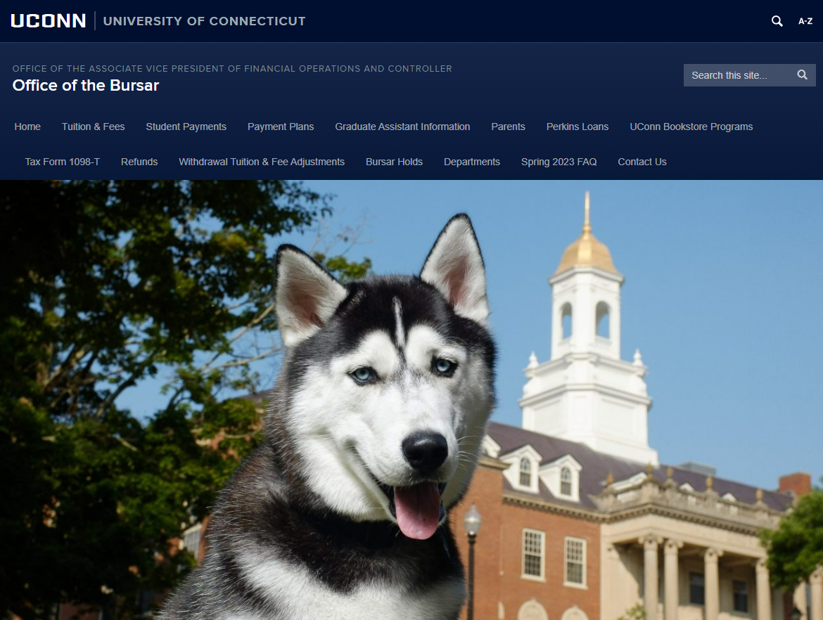
Bursar.uconn.edu
Bills for tuition & fees
Receives payments
Offers payment plans
Posts private scholarships
Invoices third-party payments
Issues refunds
Notes:
Here at UCONN, the Office of the Bursar….
bills for tuition and fees. Receives payments, offers payment plans, post private scholarships, invoices third party payments and issues refunds for overpayments on a student’s account.
Students might have overpayments refunded to them to pay for living expenses and or school supplies.

Slide 18
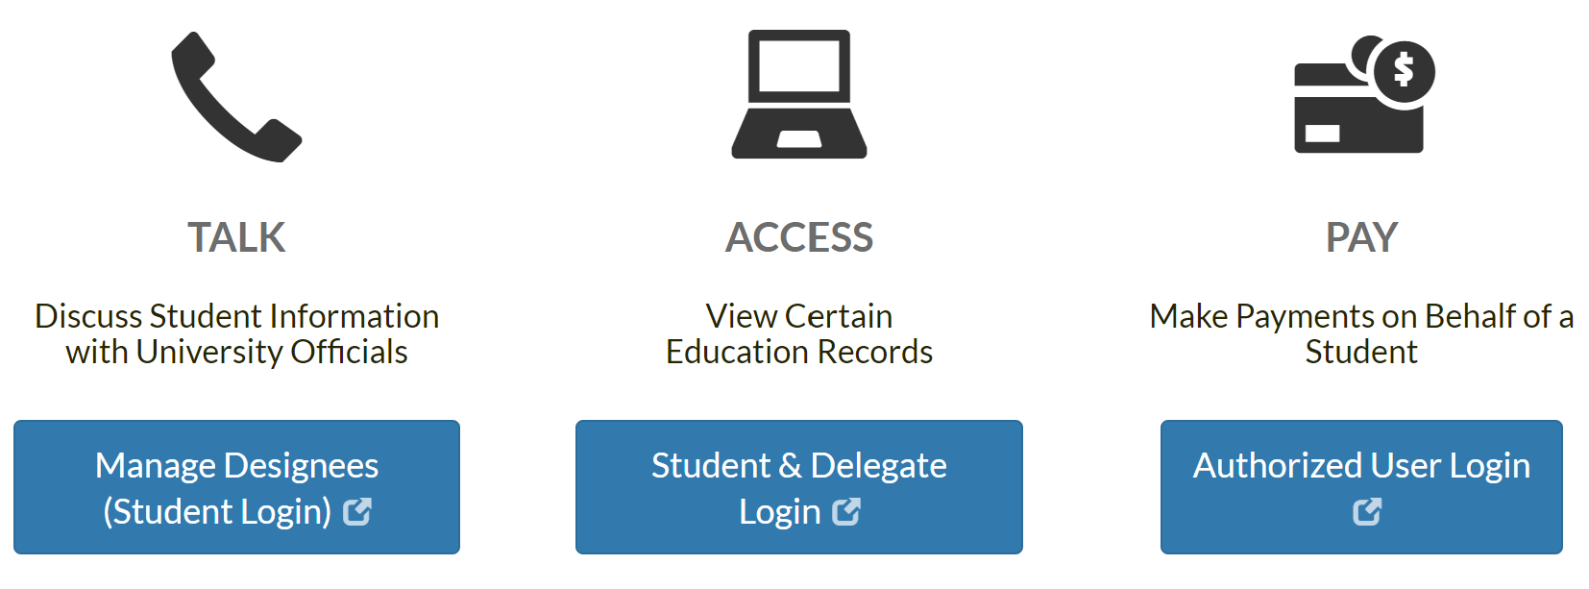
Granting Access to Student Financial Information
FERPA pin refers to a federal law requiring students to create a pin for any individual wishing to speak on behalf of the students account besides themselves.
Delegate User can only view the fee bill such as, charges to the account, fee bill due dates, received payments, refunds and deferrals placed on the account for financial aid, scholarships and or third-party payments.
Authorized User can view the fee bill, make a payment, enroll in a payment plan and download a statement with the UConn logo and address.
Bursar.uconn.edu > Home > “Share My Information (ferpa.uconn.edu)”
Phone & Email
View
View & Pay
1. FERPA Pin
2. Delegate User
3. Authorized User
Notes:
The student can grant anyone access to their student financial records by visiting our website bursar.uconn.edu, click “Share My Information” button and select the access you would like to provide.
There are 3 types of access.
First access is Manage Designees. (The talk button.) To allow us to legally talk and email with someone else about the student's bill, the student must set up a FERPA PIN for that individual. The FERPA pin refers to a federal law requiring students to create a pin for any individual wishing to speak on behalf of the students account besides themselves.
Once the students creates a 4-digit FERPA PIN, this allows access to talk about Student Financial Information.
We can only talk if they provide us that FERPA PIN. Otherwise, we cannot talk about the student's account.
The second access is Delegate Login. (The computer button. )This allows someone else to access and view your account. They can only view student records and the student decides what they can see.
Third, to allow someone else to view, pay and enroll the fee bill in a payment plan online, the student must set them up as an Authorized User.
Authorized Users will still need a 4-digit FERPA pin if they wish to email or call-in asking questions about the student's fee bill.
If you wish to grant access, please set up before the semester starts by visiting our website Bursar.uconn.edu and click “Share My Information.”

Slide 19
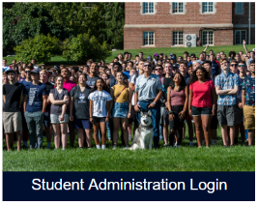
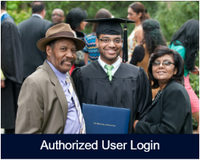
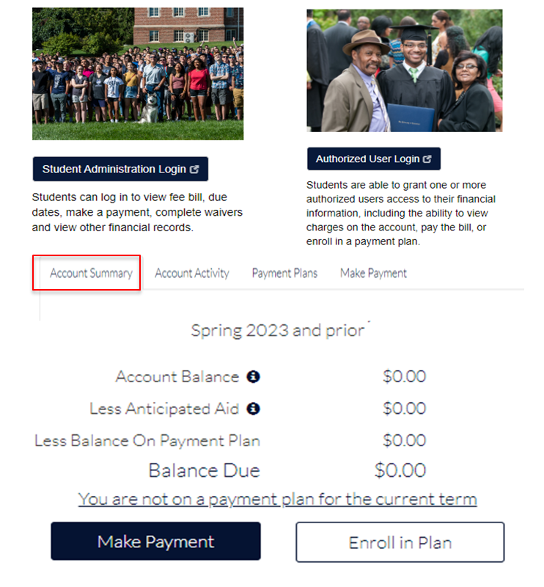
Account Summary- Payment Options
CEIN students are billed in Spring, Summer and Fall.
bursar.uconn.edu >Tuition & Fees > Additional Programs > CEIN Program
Login @ Bursar.uconn.edu
3 Types of Electronic Payments
E-check (routing & account bank numbers)
Credit & Debit Card (2.75% Convenience fee)
Wire transfer (International Students)- Convera or Flywire
Mailing Check, Money Order & 529 Payments
Address MUST include UNIT 4100
Check MUST include name & Student ID
Mail 2-4 weeks before due date to avoid receiving holds and late fees
529 account holder contacts the plan provider to send payment
University of Connecticut
233 Glenbrook Rd, Unit 4100
Storrs, CT 06269
Drop box - Wilbur Cross Building (Storrs) & regional campuses
Payment Plans
( We do not accept cash or payment over the phone.)
Notes:
CEIN students are billed in the Spring, Summer and Fall. Tuition and fees can be found on bursar.uconn.edu >Tuition & Fees > Additional Programs > CEIN Program
There are multiple ways to pay the fee bill.
Electronic payment options are the fastest and most secure methods of payment. To make a payment online, visit our website to login to be directed to the payment portal.
E-checks, or electronic checks, uses your banking information to process a secure payment online. There is no fee to pay via e-check.
Credit cards can be used online as well. To use a credit card, you will be charged a 2.75% convenience fee.
For international students, they can pay their bill via wire transfer through Convera or Flywire.
Payees can still mail a check, bank check, money order, or a 529 payment. If the payment is being delivered by mail, the payment can take up to 2 weeks depending on the mail system. It is important that these payments including 529s, are sent 2-4 weeks before the fee bill due date to avoid late fees and holds on the student's account. Please note when paying with a 529 plan, you must request a 529 check from your 529 plan provider.
When mailing a payment, the address MUST include UNIT 4100. If the address is missing 4100, we will not receive this payment. The payment can be sent to…..
University of Connecticut
233 Glenbrook Rd, Unit 4100
Storrs, CT 06269
If the payee wishes not to mail the payment, a drop box can be found on the Storrs Campus in the Wilbur Cross Building or any regional campus.
All payments being mailed or placed in the drop box, MUST include students name and ID. If the payment is missing the name and ID, we cannot post the payment to the account.
Please do not mail or place cash in the drop box!!

Slide 20
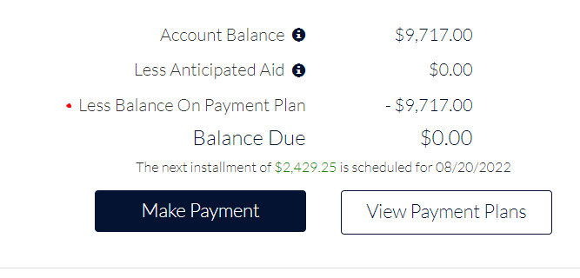
Payment Plans
Fall & Spring only
5, 4, 3-month options
Available when fee bills release
Interest Free
Balance of $300+
Students & Authorized Users can enroll
Previous semester MUST be paid off
Credit & Debit Card (2.75% fee)
NO checks and NO cash allowed
$100 to activate a payment plan
(non-refundable)
Notes:
UCONN offers 5,4 and 3-month interest-free payment plans as an alternative to one large payment to help limit loan borrowing and ease financial pressures. Students and designated authorized users may enroll in a payment plan to pay for eligible student charges.
While the plan is interest free, there is a $100 non-refundable sign-up fee for the Fall and Spring plans. The sign-up fee is deducted from your bank account or charged to your debit or credit card as soon as you complete the enrollment process.
In order to qualify for the payment plan, your account must be in good standing. All outstanding balances must be paid off first. However, any student who owes more than $300 for the current term may enroll. In addition, the student or Authorized User must be willing to allow the installment to be taken out automatically from a personal U.S. checking account or scheduled charges to a debit or credit card. Please note, Authorized Users can enroll in a payment plan on behalf of their student.
If a student or authorized user wishes to set up a 5-month installment plan, they will need to sign up when fee bills are issued. After each enroll by due date, the amount of payment plan offers decrease, so we recommend signing up early. Installments will be deducted on the 20th of each consecutive month.
If you receive financial aid, loans, grants or awards after your payment plan is created, your account will rebalance showing your new installment amounts.
If you miss 2 installments, October installment in the fall and March installment in the spring, you risk being unenrolled, receiving late fees and holds.
Please note, UCONN does not offer payment plans for the summer and winter sessions. For more information on our payment plans, please visit our website!

Slide 21
Common questions for not paying on time…
Can I attend classes and move into my dorm if I did not pay?
Yes. We do not drop courses for non-payment and students can still move into their dorm
Will I be charged late fees for missing a payment?
Yes, up to $300 for late payments
Will late payments impact my access to services on campus? Yes
Holds will be placed
Can’t register for upcoming semester
No access to Rec Center
No access to official transcripts
Notes:
If the student or Authorized User does not pay the fee bill on time.......holds, late fees and other penalties may apply to the student's account.
They can still attend classes they are enrolled in and move into their dorm. We do not drop students from classes or move students out of their dorm for late payment.
However, they will be at risk receiving late fees up to $300 per semester.
They will be unable to register for classes, go to the Rec Center, or request an official transcript until their account is paid in full and their Bursar hold is removed.

Slide 22
Quick Links
Notes:
Before the semester starts, we recommend students logging in to student administration to complete important tasks found in quick links.
In quick links you will be able to
Set up Authorized Users & FERPA designees
Waive the university health insurance
Complete the title IV waiver if you are receiving financial aid
Sign up for direct deposit
And optout of the Husky Book Bundle if you are a full time undergraduate

Slide 23
Health Insurance Fee
Mandatory Health Insurance Options
Personal health insurance
Plan carried by their parents
University Sponsored Health Insurance (Full year)
Waiving University Sponsored Health Insurance
Optional to waive fee off bill
Must have health insurance
Login to pay bill (Quick Links)
No waive, must pay
9/15 last day to waive!
Notes:
Full-time students are required to carry health insurance. If the student is covered under another plan and they do not wish to enroll in the University sponsored health insurance plan, the health insurance waiver must be completed every year by September 15^{th.} Otherwise, the student will be responsible for the cost for that academic year. The waiver only covers one academic year at a time.
The student will log in to pay fee bill and visit quick links to waive health Insurance. The student will need to upload proof of current health insurance.

Slide 24
Husky Book Bundle Fee
Partnership with UConn Barnes & Noble Bookstore
$285 Rental Fee charged to Fall and Spring Fee Bill
Covers required course materials
Available to full-time CEIN & undergraduate students
Rental books are due last day of finals
Must opt out 30 days prior to 1st day of class & ends on the 10th day of class
For more information visit bookbundle.program.uconn.edu.
Notes:
Husky Book Bundle Program is through a partnership with UConn Barnes & Noble Bookstore.
… the program will help reduce the cost of traditional textbooks up to 50%.
The Husky Book Bundle is a textbook savings program that delivers student course materials at a reduced price.
The program will provide an affordable option and supports student success by ensuring every participating student is prepared for the first day of class.
The program is only available to full-time undergraduate students. The Husky Book Bundle RENTAL fee will be charged directly to the student's fee bill.
IF the student wishes not to enroll in the Husky Book Bundle Program, they will have the option to opt-out of this program. The opt-out period for each semester is open 30 days prior to the first day of class and ends on the 10th day of class. Once opted out, the student will be responsible for obtaining all necessary course materials via another method. If the student wishes not to opt out, they must return all course materials at the end of the semester to the bookstore.
Students will receive an email from the bookstore with a link to choose a delivery method for their materials. They can also choose to opt-out of the program through the link in the bookstore’s email. For convenience, the link to opt-out is also available through the Quick Links section in the fee bill payment portal,
For more information visit bookbundle.program.uconn.edu

Slide 25
Title IV Waiver
Completing the Title IV Waiver allows federal financial aid to cover miscellaneous fees. Per Federal regulations, we can only apply Title IV aid to tuition, mandatory fees, UConn room and board.
Miscellaneous Fees
• University Sponsored Health Insurance
• Husky Book Bundle Fee
• Health service fees
• Husky One Card charges
• Library charges
• Parking fines
Notes:
* Federal Financial Aid is called “Title IV” aid. Per Federal regulations, we can only apply Title IV aid to tuition, mandatory fees, and UConn room and board.
By completing the Title IV waiver, federal aid can apply to miscellaneous fees such as but not limited to, University Sponsored Health Insurance, health service fees, Husky Book Bundle, Husky One Card charges, library charges and parking fines. We cannot apply Title IV aid to these charges without the student's permission.
Please note that even with this Title IV waiver, federal funding cannot apply to past due balances from prior academic years, late fees, payment plan enrollment fees, or other financial charges.
If you do not fill the form out prior to your aid disbursing and do not waive your health insurance, you risk owing a balance. For example, if you ask for a set amount of aid that included the University Sponsored Health Insurance Fee, you will receive a refund due to not filling out the waiver. You will then need to turn around and pay off your balance.

Slide 26
Private Scholarships
Visit “Quick Links” for instructions on how to submit online
https://bursar.uconn.edu/private-scholarship-deferment/
Deferrals can be placed on the fee bill acting as a place holder. (We can’t defer private scholarships based on GPA)
Fall Deferral Expiration Date - October 1st
Spring Deferral Expiration Date- March 1st
Scholarships split evenly between Fall and Spring terms unless noted in the scholarship letter or under $2,000
What happens if we don’t receive the payment by the scholarship deferral date?
Deferral will fall off by the above date showing a balance owed
You will need to contact the scholarship provider to confirm address and when payment will be sent
Send to: University of Connecticut
233 Glenbrook Rd, Unit 4100
Storrs, CT 06269-4100
Notes:
Private scholarships
The student must submit the official scholarship letter by
Visiting our website, scrolling to the bottom of our home page, click “Private Scholarships” and then click “Submit Private Scholarship.”
The student can ALSO log in to pay fee bill, see “Quick Links” to the right and “Submit Private Scholarship.”
Please note UConn does not invoice scholarships.
UConn splits the scholarship amount evenly between Fall and Spring terms unless noted in the letter or under $2,000.
For example, a scholarship of $5000 will be split evenly between the fall and spring. $2500 will be deferred for each term.
A scholarship of $3,000 that says in the award letter it is only for the fall term will be deferred for the fall only.
A scholarship for $500 will only be deferred to that term.
To receive a deferral, the scholarship cannot be based on your GPA, class schedule, or other factors of your studies.
The Office of the Bursar can defer the scholarship only if the letter is received before October 1st for fall or March 1st for Spring.
If we do not receive the scholarship by those dates, the deferral will fall off the fee bill showing a balance. The student will be financially responsible for the balance and will need to contact the scholarship provider.

Slide 27
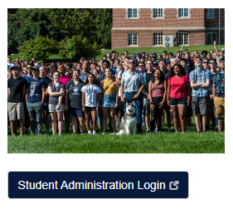
Direct Deposit
Refund checks will be issued within 14 days of Financial Aid disbursement in the beginning of the semester.
Direct Deposit
MUST have a US bank account and a US address
Login to student admin> Bursar Services> Pay Bill> Quick Links
Allow 1-3 business days to arrive in bank account
International students that paid wire transfer will receive refund via wire transfer
Paper check refund will be….
Cut & mailed on Wednesdays
Takes 1-2 weeks to receive depending on mail system
Refund checks are issued remotely by Bank of America and mailed to the mailing address on file
Notes:
Most UConn students receive some form of refund during their studies.
Refund checks for the beginning of a semester will be issued within 14 days of Financial Aid disbursement.
Checks are not available for in-person pickup. Refund checks are cut on Wednesday and mailed to the address on file and may take 1-2 weeks to receive. It will be the student's responsibility to update their address on file if they wish to receive a paper check.
Due to these reasons, we recommend all students to enroll in direct deposit. Please allow 1-3 business day for refund to arrive in students bank account.
The student can sign up for direct deposit in quick links. The student will need to enter their routing and account bank numbers. An email notification will be sent to the student once they are enrolled in Direct Deposit.

Slide 28
Contact Information
Client Service Center
860-486-4830
bursar@uconn.edu
bursar.uconn.edu
uconnbursar
Notes:
** You can reach the Office of the Bursar by calling our Client Service Center at 860-486-4830 or by email at bursar@uconn.edu.
Thank you and we wish you the best during your time here at UCONN.

