Slide 1
Financial Aid and Payment Information
2025 Certificate Entry Into Nursing Program
Presented by:
The Office of Student Financial Aid Services
& The Office of the Bursar

Slide 2
Office of Student Financial Aid Services
Discussion Topics:
Complete the FAFSA
Determining Dependency Status
Federal and Private Loan Options
Fixed Enrollment Date – Day 10
Contact Information
Jonathan XIV, Jonathan XV, Tildy, and Carson, UConn - Storrs – January 2024

Slide 3
Complete the FAFSA (Free Application for Federal Student Aid)
Complete two FAFSAs:
2024-2025 FAFSA (spring and summer semester aid)
Available now
2025-2026 FAFSA (fall semester aid)
Available on or before 12/1/2024
Studentaid.gov
Financial Aid Offers typically available:
Spring Semester: Mid-November
Summer Semester: April (or after you register)
Fall Semester: Late-May

Slide 4
Complete the FAFSA (Free Application for Federal Student Aid)
Studentaid.gov - UConn’s school code is 001417.
Accurate answers to the following questions, on the FAFSA:
When the student begins the 2024–25 school year, what will their college grade level be? Other Undergraduate (Junior Year and Beyond)
When the student begins the 2024–25 school year, will they already have their first bachelor’s degree? Yes
Group of students standing and jumping at the fountain in the outdoor courtyard at UConn – Waterbury, April 19, 2022.

Slide 5
Determining Dependency Status
The FAFSA will determine if you will be considered a dependent student and will be required to provide parental information.
Example of some of the questions asked on the 24/25 FAFSA:
What is your date of birth? (For 24/25 you are an independent student if you were born before 1/1/2001.)
When the student begins the 2024-2025 school year, what will their college grade level be? Correct Answer: Other Undergraduate (Junior Year and Beyond)
The student has children or other people (excluding their spouse) who live with the student and receive more than half of their support from the student between July 1, 2024, and June 30, 2025? (Select if this applies.)

Slide 6
CEIN Program - Forms of Aid
School of Nursing - Merit Scholarships
Federal
Direct Loans
Private Alternative Loans
Group of students outdoors in the courtyard waving, at UConn – Waterbury, on April 10, 2024.

Slide 7
Undergraduate Loans at a Glance
Loan | Borrower | Credit Check Required? | Interest Rate As of 7/1/24* | Repayment Begins
Federal Direct Subsidized Loan | Students with financial need | No | 6.53% | Six months after graduation
Federal Direct Unsubsidized Loan | Students | No | 6.53% | Six months after graduation
Federal Direct Parent PLUS Loans | Parents of Dependent Students | Yes | 9.08% | Sixty days after second disbursement unless deferred
Private/Alternative Loans | Students (Some may need a creditworthy cosigner.) | Yes | Variable or fixed; usually depends on borrower and cosigner credit scores | Varies by loan product
* Interest rates subject to change effective July 1, 2025.

Slide 8
Federal Direct Student Loans per Semester
Semester | Dependent Student Federal Direct Loans | Independent Student Federal Direct Loans
Spring | $3,750 | $6,250
Summer | $3,750 | $6,250
Fall | $4,688 | $7,813
Welcome Center at UConn - Avery Point

Slide 9
Undergraduate Aggregate Federal Direct Loan Limits
Student Status | Federal Direct Subsidized Loan Limit | Total Loan Limit
Dependent Undergraduate | $23,000 | $31,000
Independent Undergraduate | $23,000 | $57,500
Students walk across UConn – Storrs amongst the fall foliage on Oct. 24, 2023.

Slide 10
Federal Direct Student Loan Requirements
Students must complete the following requirements if they would like to borrow Federal Direct Student Loans after a FAFSA is filed.
Loan Entrance Counseling
studentaid.gov
Accept Loan Offer
Student Administration System
Master Promissory Note
studentaid.gov

Slide 11
Federal Direct Parent (PLUS) Loans for Dependent Undergraduate Students
Parents of Dependent students can apply for a Federal Direct PLUS Loan
Three Applications – Spring, Summer, Fall
A parent completes an online application and, if approved, a Master Promissory Note on studentaid.gov
A parent can apply for each semester: spring, summer, and fall (if the student remains dependent)
Credit check will be performed by the US Department of Education

Slide 12
Apply for a Private (Alternative) Loan
Both dependent and independent students can apply for a Private Alternative Loan.
Students who do not have established credit will need a credit worthy co-signer.
UConn's Suggested Private (Alternative) Loan Lender list via ELMSelect: financialaid.uconn.edu/altloan/
Variable or fixed interest rates; many have no cap
Repayment options vary by lender
Students apply directly with their chosen lender.
Apply once per semester: spring, summer, fall
Spring Loan Period: January to May 2025
Summer Loan Period: May to August 2025
Fall Loan Period: August to December 2025
Students walking down the stairs in the courtyard (atrium) UConn - Stamford on Sept. 19, 2024

Slide 13
Cost of Attendance – Additional Loans
Students can receive financial aid up to their Cost of Attendance (COA) budget, which includes direct and indirect costs.
Students can apply for additional loan funds* to assist with the remaining fee bill, and for other educational expenses.
* See the previous two slides.
Dependent students can apply for an additional loan. If approved, the maximum additional loan amount is an estimated $21,000 per semester.
Independent students can apply for an additional loan. If approved, the maximum additional loan amount is an estimated $18,500 per semester.

Slide 14
Spring 2025 CEIN Cost of Attendance
COA Budget Item | Storrs On/Off Campus | Storrs with Parent | Regional On/Off Campus | Regional with Parent
Program Fee | $13,005 | $13,005 | $13,005 | $13,005
Additional Fees | $498 | $498 | $428 | $428
Room and Board | $7,575 | $2,065 | $8,911 | $2,065
Miscellaneous | $955 | $625 | $955 | $625
Books | $1,500 | $1,500 | $1,500 | $1,500
Transportation | $1,210 | $1,369 | $1,210 | $1,369
Loan Fees | $46 | $46 | $46 | $46
Total Direct Costs | $13,503 | $13, 503 | $13,433 | $13,433
Total COA Budget | $24,789 | $19,108 | $26,055 | $19,038
Students can view their COA in the Student Administration system.
Financial Aid tile > FA Summary > COA per semester

Slide 15
Fixed Enrollment Date-Day 10
Financial Aid offers are based on the assumption that students will enroll full-time on or before the tenth day of classes, each semester.
If you are not enrolled full-time (12 or more credits) by Day 10, your financial aid offer could potentially be reduced or cancelled.
Spring Semester Day 10: February 3, 2025
Exterior views of UConn - Stamford on Sept. 19, 2024

Slide 16
One Stop Student Services
Questions for Financial Aid or the Registrar?
Contact One Stop Student Services:
Open Monday – Friday
8:00AM – 5:00PM EST
Email - onestop@uconn.edu
Telephone - (860) 486-1111
In-Person - Wilbur Cross Building, Storrs Campus
UConn’s Regional Campuses each have staff available to assist students with financial aid questions as well.
Visit our website for additional information:
financialaid.uconn.edu/cein/
Wilbur Cross Building, UConn - Storrs

Slide 17
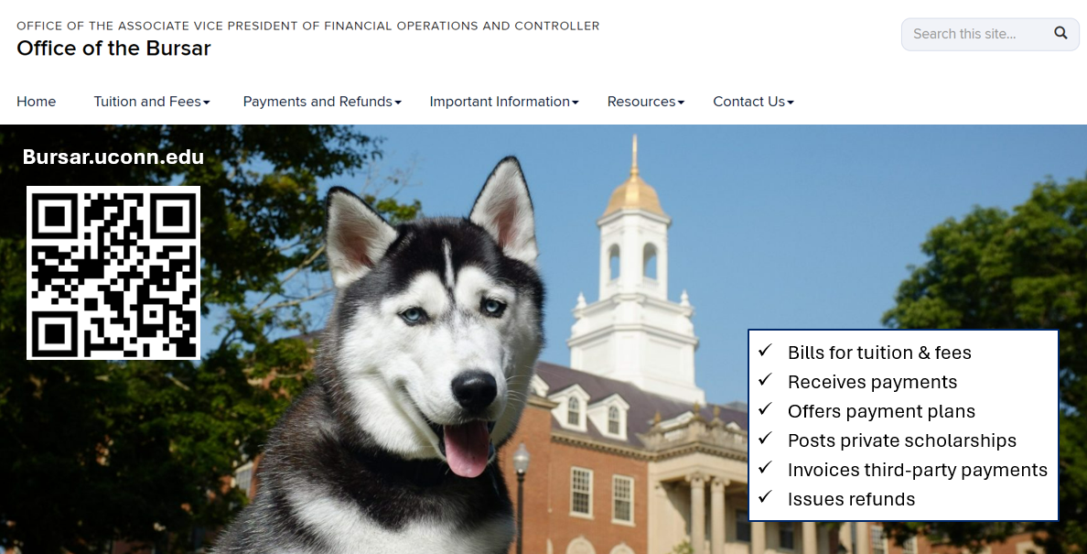
Agenda
Notes:
Here at UCONN, the Office of the Bursar bills for tuition and fees. Receives payments, offers payment plans, post private scholarships, invoices third party payments and issues refunds for overpayments on a student’s account.
Students might have overpayments refunded to them to pay for living expenses and or school supplies.

Slide 18
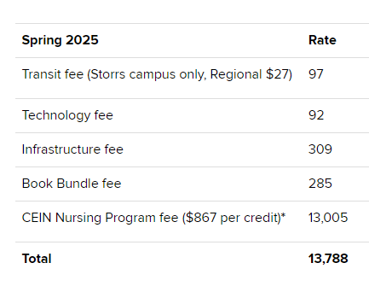
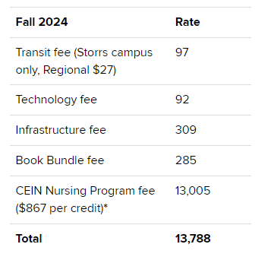
CEIN 2025-2026 Tuition & Fees
When will you be billed?
2025- Spring, Summer and then Fall
2025
TBD
TBD
TBD
TBD
TBD
TBD
Notes:
The CEIN program is a full time 12-month program. Students will receive three bills. The first one in the spring, summer and then fall.
Spring and Summer 2025 Students will be billed $867 per credit along with mandatory fees that are non waivable. Fall 2025 tuition and fees will be posted on our website mid Spring 2025. For a description of mandatory fees, please visit our website bursar.uconn.edu .

Slide 19
Agenda
Granting Access to Student Financial Information
FERPA
Family Educational Rights & Privacy Act of 1974 - Protect Integrity of a Student’s Academic Record & Protect Students Privacy
The FERPA pin refers to a federal law requiring students to create a pin for any individual wishing to speak on behalf of the students account besides themselves.
Delegate User
This allows someone else to access and view the students account. They can only view student financial records.
Authorized User
To allow someone else to view, pay and enroll the fee bill in a payment plan online, the student must set them up as an Authorized User.
Authorized Users will still need a 4-digit FERPA pin if they wish to email or call-in asking questions about the student's fee bill.
To view and download the 1098-T Form, the Authorized User must be set up as a Delegate User.
Notes:
The student can grant anyone access to their student financial records by visiting our website bursar.uconn.edu. Here they may find step-by-step instructions on how to set parents and guardians up.
There are 3 types of access.
First access is FERPA. Known as the Family Educational Rights & Privacy Act of 1974. The goal is to protect the student’s academic record & protect students' privacy
To allow us to legally talk and email with someone else about the student's bill, the student must set up a FERPA PIN for that individual. The FERPA pin refers to a federal law requiring students to create a pin for any individual wishing to speak on behalf of the students account besides themselves.
Once the students creates a 4-digit FERPA PIN allowing access to talk about student financial information, we may then open the student’s account and communicate with the parent and guardian. Otherwise, we cannot talk about the student's account.
The second access is Delegate User. This allows someone else to access and view the students account. They can only view student records and download the 1098-T tax form. The student decides what they can see.
Third access is an Authorized User. To allow someone else to view, pay and enroll the fee bill in a payment plan online, the student must set them up as an Authorized User. Authorized Users will still need a 4-digit FERPA pin if they wish to email or call-in asking questions about the student's fee bill. Please note in order to view and download the 1098-T Form, the Authorized User must be set up as a Delegate User.
If you wish to grant access, please set up before the semester starts by visiting our website Bursar.uconn.edu and click “Share My Information.”

Slide 20
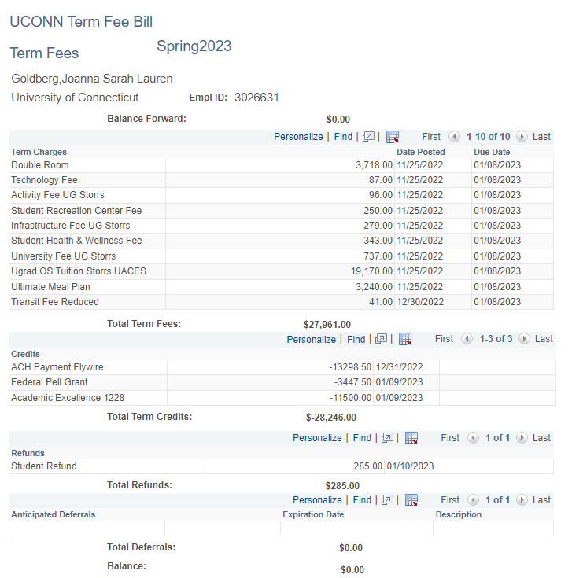
Agenda
Delegate User & Student - View Fee Bill
Login @ bursar.uconn.edu
Notes:
To view the fee bill, the student and Delegate User, will need to visit our website to login.
Once the fee bill is pulled up, it is important to understand what each section means.
The top section states charges, or in other words, tuition, fees, and any other expenses the student will have to pay for. There will be a due date for each charge.
The next section is the credits section. This section represents any payments that were made out-of-pocket, loans, scholarships, waivers, or anything else that will pay the bill.
Refunds are issued if the bill is overpaid. If the credit is from a parent plus loan, the refund will be issued to the borrower unless indicated the refund can go to the student when the application was completed.
Anticipated Deferrals are payments that are expected to come in and post on the student's fee bill.
Deferrals are most commonly placed when UConn is expecting a loan, a private scholarship and or the fee bill has been enrolled in a payment plan. Please note that if the funds do not come in, the student will be financially responsible for the remaining balance.
The balance at the bottom of the screen is the amount they owe. If the balance is negative, it means the account has been overpaid.
To login, please visit our website, click Student Administration or Delegate Login.

Slide 21
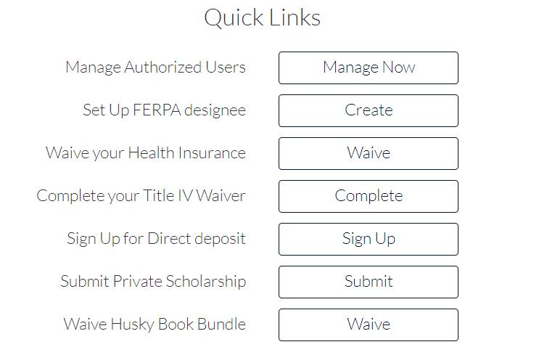
Agenda
Authorized User & Student– Payment Portal Overview
Login @ bursar.uconn.edu
Notes:
The student and Authorized User login can be found on our home page.
For the student to be directed to the payment portal, the student will login, click “Bursar Services” and then click “Pay Bill.”
Authorized Users will login and be directed straight to the payment portal.
Once the student and Authorized User is logged in, they can view account summary, account activity and quick links.
The “Account Summary” shows their balance and anticipated aid. They can make a payment and enroll in a payment plan.
To view current and past fee bill details, click “Account Activity.”
To submit forms and waivers, visit “Quick Links.”

Slide 22
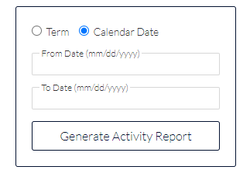
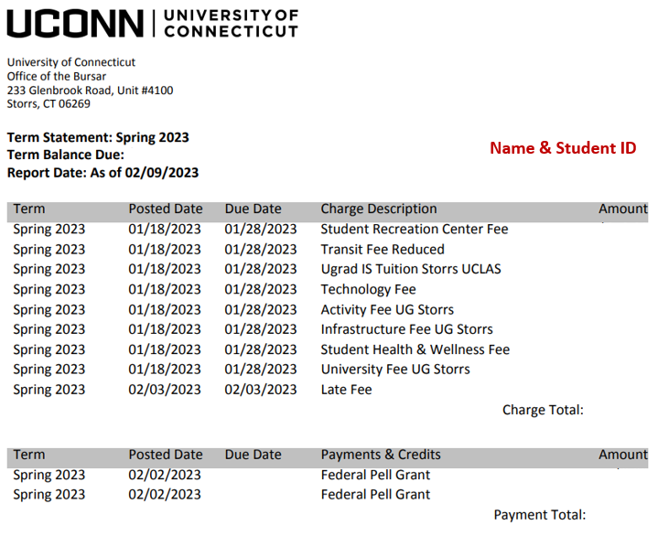
Agenda
Account Activity- View & Download Fee Bill
Notes:
The student and Authorized User can login and click the tab “Account Activity” to view and download detail statements for current and past terms with the student's name, ID, UConn Logo and address. The statement will have a breakdown of the tuition, fees and payments. The statement can also be used as an invoice.

Slide 23
Agenda
Account Summary- Payment Options
3 Types of Electronic Payments
E-check
Credit & Debit Card (2.75% Convenience fee)
Wire transfer – Convera & Flywire (International Students- No US bank account or US address)
Mailing Check, Money Order & 529 Payments (No Cash Excepted)
Payments MUST be sent 2-4 weeks before due date to avoid receiving holds and late fees.
529 account holder must contact the plan provider to send payment
Send mail payments to address:
University of Connecticut
233 Glenbrook Rd, Unit 4100
Storrs, CT 06269
MUST include UNIT 4100 in address, students name and PeopleSoft ID on check
Drop box available- Wilbur Cross Building (Storrs) & regional campuses
Payment Plans
Notes:
There are multiple ways to pay the fee bill.
Electronic payment options are the fastest and most secure methods of payment. To make a payment online, visit our website to login to be directed to the payment portal.
E-checks, or electronic checks, uses your banking information to process a secure payment online. Here you will enter your routing and account bank numbers. There is no fee to pay via e-check.
Credit cards can be used online as well. To use a credit card, you will be charged a 2.75% convenience fee.
For international students and individuals who do not have a US bank account or US address may wire funds through Convera & Flywire
Payees can still mail a check, bank check, money order, or a 529 payment. If the payment is being delivered by mail, the payment can take up to 2 weeks depending on the mail system. It is important that these payments including 529s, are sent 2-4 weeks before the fee bill due date to avoid late fees and holds on the student's account. Please note when paying with a 529 plan, you must request a 529 check from your 529 plan provider. The mail payments can be sent to…..
University of Connecticut
233 Glenbrook Rd, Unit 4100
Storrs, CT 06269
When mailing a payment, the address MUST include UNIT 4100. If the address is missing 4100, we will not receive this payment.
If the payee wishes not to mail the payment, a drop box can be found on the Storrs Campus in the Wilbur Cross Building or any regional campus. All payments being mailed or placed in the drop box, MUST include students name and ID. If the payment is missing the name and ID, we cannot post the payment to the account.
Please note we do not accept cash or payments over the phone.

Slide 24
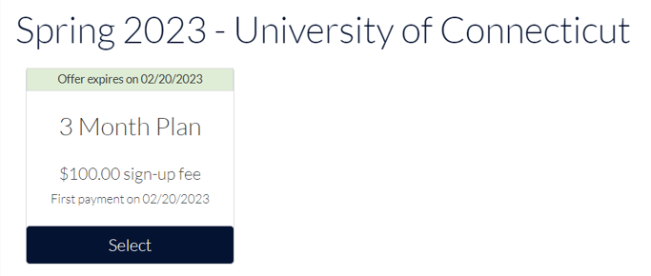
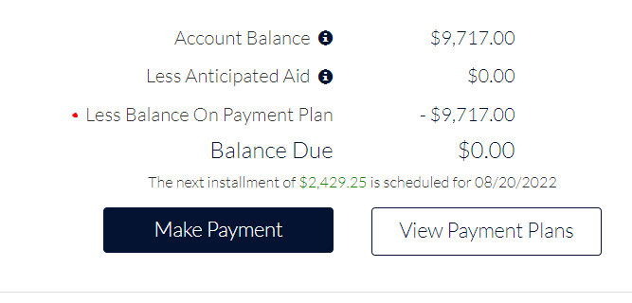
Agenda
Payment Plans
Fall & Spring ONLY
5, 4 & 3 Installment Payment Plans
Interest Free
MUST enroll by the fee bill due date to avoid holds and late fees
Monthly installments
Previous semester MUST be paid off
Balance of $300+ may enroll
Credit & Debit Card (2.75% fee)
NO checks and NO cash allowed
$100 Non-Refundable Fee to activate payment plan each semester
(Year)
Notes:
UConn offers 5,4 and 3-month interest-free payment plans as an alternative to one large payment to help limit loan borrowing and ease financial pressures. Students and designated Authorized Users may enroll in a payment plan to pay for eligible student charges. If a student or Authorized User wishes to set up a 5-month installment plan, they will need to sign up when fee bills are issued. After each enroll by due date, the amount of payment plan offers decrease, so we recommend signing up early.
To qualify for the payment plan, your account must be in good standing. All outstanding balances must be paid off first. However, any student who owes more than $300 for the current term may enroll. In addition, the student or Authorized User must be willing to allow the installment to be taken out automatically from a personal U.S. checking account or scheduled charges to a debit or credit card.
While the plan is interest free, there is a $100 non-refundable sign-up fee for the Fall and Spring plans. The sign-up fee is deducted from your bank account or charged to your debit or credit card as soon as you complete the enrollment process. If the student or Authorized User misses the installment date, the student will then be removed from the payment plan causing a balance due on their account, risk receiving holds and up to $300 in late fees.
If you receive financial aid, loans, grants or awards after your payment plan is created, your account will rebalance showing your new installment amounts.
Please note, UCONN does not offer payment plans for the summer and winter sessions. For more information on our payment plans, please visit our website!

Slide 25
Agenda
Quicks Links
(Year)
Notes:
Before the semester starts, we recommend students logging in and complete important tasks found in quick links.
In quick links you will be able to…
Set up Authorized Users & FERPA designees
Waive the university health insurance
Complete the title IV waiver if you are receiving financial aid
Sign up for direct deposit
And optout of the Husky Book Bundle if you wish to.
Today, we will be talking about the 5 tasks that are starred under quick links.

Slide 26
Agenda
Mandatory Health Insurance Options
Personal health insurance
Plan carried by their parents
University Sponsored Health Insurance (Full year)
Waiving University Sponsored Health Insurance
Optional to waive fee off bill
Must have health insurance
Login to pay bill (Quick Links)
No waive, must pay
Waive by:
Fall Semester- September 15th $3190 (Full year)
Spring Semester- February 5th -$1595 Newly admitted students (Half a year)
Notes:
Full-time students are required to carry health insurance. If the student is covered under another plan and they do not wish to enroll in the University sponsored health insurance plan, the health insurance waiver must be completed every year in the fall by September 15^{th.} For newly admitted students that will be starting in the spring, they will be billed for half of the insurance. The newly admitted spring student will need to waive the health insurance by February 5th.
In the Fall, the student will then be charged the full amount. The waiver only covers one academic year at a time. If the student does not waive the health insurance, they are financially responsible.
The student will log in to Student Admin to upload proof of current health insurance and complete the waiver.

Slide 27
Agenda
Husky Book Bundle Fee
Partnership with Barnes & Noble Bookstore
Rental Fee charged to the fee bill per semester
Reduces cost of traditional textbooks up to 50%
Covers required course materials
Available to full-time undergraduate students
Student may have books mailed or can pick up before first day of classes
Rental books are due last day of finals
Must opt out 30 days prior to 1st day of class & ends on the 10th day of class if student wishes to purchase books on their own
For more information visit: bookbundle.program.uconn.edu
Notes:
Husky Book Bundle Program is through a partnership with UConn Barnes & Noble Bookstore. The program will help reduce the cost of traditional textbooks up to 50%.
The Husky Book Bundle is a textbook savings program that delivers student course materials at a reduced price.
The program will provide an affordable option and supports student success by ensuring every participating student is prepared for the first day of class.
The program is only available to full-time undergraduate students. The Husky Book Bundle RENTAL fee will be charged directly to the student's fee bill.
IF the student wishes not to enroll in the Husky Book Bundle Program, they will have the option to opt-out of this program. The opt-out period for each semester is open 30 days prior to the first day of class and ends on the 10th day of class. Once opted out, the student will be responsible for obtaining all necessary course materials via another method. If the student wishes not to opt out, they must return all course materials at the end of the semester to the bookstore.
Students will receive an email from the bookstore with a link to choose a delivery method for their materials. They can also choose to opt-out of the program through the link in the bookstore’s email. For convenience, the link to opt-out is also available through the Quick Links section in the fee bill payment portal,
For more information visit bookbundle.program.uconn.edu.

Slide 28
Agenda
What are Federal Title IV Funds?
Title IV Funds = Federal Student Aid Funds
Federal student aid programs administered by the U.S. Department of Education
Title IV Funds include:
Federal Direct Subsidized/Unsubsidized Student Loans
Federal Direct Parent PLUS Loan
What charges does Federal Student Aid Funds pay for?
The U.S. Department of Education regulations only allow schools to use your Federal Student Aid to pay for current academic year institutional allowable charges, unless you have granted permission to apply these funds to non-allowable charges as well.
Allowable charges:
Tuition
Mandatory fees
University Room & Board
Non-Allowable/ Miscellaneous charges include:
Health insurance
Husky Book Bundle
Husky One Card charges
Health service/lab fees
Parking & Library fines
Notes:
Title IV funds are federal student aid funds, which are from federal student aid programs administered by the U.S. Department of Education. The U.S. Department of Education regulations only allow schools to use federal student aid to pay for current academic year institutional charges unless the student has granted permission to apply these funds to non-institutional charges.
The U.S. Department of Education regulations only allow schools to use your Federal Student Aid to pay for current academic year institutional allowable charges, unless student granted permission to apply these funds to non-allowable charges as well.
Per Federal regulations, UConn can only apply Title IV aid to allowable charges such as tuition, mandatory fees, room and board contracted with the university.
Non-Allowable Miscellaneous charges may include UConn Sponsored Health insurance, Husky Book Bundle, Husky One Card charges, Health service, lab fees, Parking and Library fines.

Slide 29
Title IV Waiver
What is the purpose of Title IV Waiver?
Completing the Title IV Waiver, you are agreeing to authorize Title IV Funds (Federal Financial Aid) to be applied to all charges!
"I wish to authorize use of my Title IV financial aid funds to pay any and all charges within the academic year."
Example- Authorizing
Student is receiving financial aid.
Student completed the Title IV Waiver.
Enrolled in the Husky Book Bundle.
Financial Aid is allowed to cover the Husky Book Bundle.
Example- Not Authorizing
Student is receiving financial aid.
Student did not complete the Title IV Waiver.
Enrolled in the Husky Book Bundle.
Financial aid is NOT allowed to cover the Husky Book Bundle.
Student may receive a refund for Husky Book Bundle.
Student NOW RISKS OWING back the Husky Book Bundle Fee.
Student will then need to pay off balance even though they received a refund.
Don’t forget to complete the Title IV Waiver!
Notes:
By completing the Title IV waiver, you are agreeing to authorize Title IV Funds (Federal Student Financial Aid) to be applied to ALL charges. This includes allowable and non-allowable charges mentioned on previous slide.
IF the form is NOT completed BEFORE financial aid is placed on the fee bill, the student may RISK owing a balance. Please see examples below.
Example 1- Authorizing by completing the Title IV Waiver
Student is receiving financial aid.
Student completed the Title IV Waiver.
Enrolled in the Husky Book Bundle.
Financial Aid is allowed to cover the Husky Book Bundle.
Example- Not Authorizing
Student is receiving financial aid.
Student did not complete the Title IV Waiver.
Enrolled in the Husky Book Bundle.
Financial aid is NOT allowed to cover the Husky Book Bundle.
Student may receive a refund for Husky Book Bundle. If you ask for a set amount of aid that included the Husky Book Bundle, a refund will be issued due to not filling out the Title IV Waiver and will then owe it back. UConn MUST refund the excess funds, unless permission is granted to do otherwise.
Student NOW RISKS OWING back the Husky Book Bundle Fee. If the student owes back, they now risk receiving Bursar Holds and Late Fees for not paying the full balance by the fee bill due date.
Does the authorization form need to be signed each year?
No. The authorization remains in effect while a student at UConn. It may be changed by sending an email request to the Bursar’s Office. To avoid being refunded and owing back, please complete the Title IV Waiver BEFORE financial aid disburses to the fee bill.

Slide 30
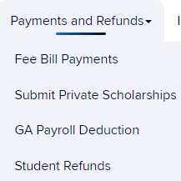
Agenda
Private Scholarships
What are private scholarships?
Private scholarships are financial awards given by companies, service groups, foundations, organizations and individuals from outside of UConn.
How do I submit my private scholarship letter?
Bursar.uconn.edu > Payments & Refunds
Quick Links in Flywire> Instructions- How To
What happens after we receive your letter?
Scholarships split evenly between Fall and Spring terms unless noted in the scholarship letter or under $2,000
Deferrals are placed on the fee bill acting as a place holder until the payment has been received. (Scholarships based on GPA we are unable to defer)
Fall- October 1st
Spring – March 1st
University of Connecticut
233 Glenbrook Rd, Unit 4100
Storrs, CT 06269-4100
Notes:
Private scholarships
What are private scholarships?
Private scholarships are financial awards given by companies, service groups, foundations, organizations and individuals from outside of UConn.
How do I submit my private scholarship letter?
The student must submit the official scholarship letter by visiting our website, clicking “Payment and Refunds” and “Submit Private Scholarships”. If the student forgets how to submit their private scholarship letter(s), they can login to Student Admin to access the payment portal where they can click “Submit Private Scholarships” under “Quick Links” for instructions on how to submit.
What happens after we receive your letter?
Scholarships split evenly between Fall and Spring terms unless noted in the scholarship letter or under $2,000
For example, a scholarship of $5000 will be split evenly between the fall and spring. $2500 will be deferred for each term.
A scholarship of $3,000 that says in the award letter it is only for the fall term will be deferred for the fall only.
A scholarship for $500 will only be deferred to that term.
To receive a deferral, the scholarship cannot be based on your GPA, class schedule, or other factors of your studies.
The Office of the Bursar can defer the scholarship only if the letter is received before October 1st for fall or March 1st for Spring.
If we do not receive the scholarship by those dates, the deferral will fall off the fee bill showing a balance. The student will be financially responsible for the balance and will need to contact the scholarship provider.
Please note UConn does not invoice scholarships.

Slide 31
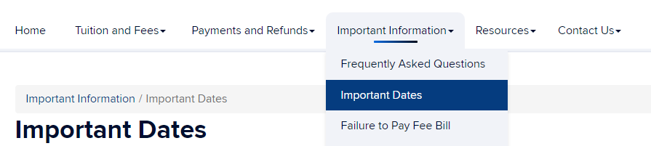
Agenda
What happens on Day 10?!
Last day to add or drop classes
Last day to add or waive the Husky Book Bundle Fee
Last day to enroll in a payment plan
Last day fee bill will decrease if student drops below full-time status, which means…
Student will then be financially responsible for the class dropped after Day 10
Financial aid may be adjusted based on registration at Day 10 if the student drops below 12+ credits/ full-time status
Notes:
What happens on Day 10?!
Day 10 is the..
Last day to add or drop classes.
Last day to add or waive the Husky Book Bundle Fee.
Last day fee bill will decrease if student drops below full-time status, which means…
Student will then be financially responsible for the class dropped after Day 10.
Financial aid may be adjusted based on registration at Day 10 if the student drops below 12+ credits/ full-time status

Slide 32
Agenda
Refunds
When are refunds issued?
Within the 14 days of classes when financial aid is disbursed to fee bills accounts with overpayments are automatically refunded
After students may request refund in Student Admin
3 Types of Refunds
Direct Deposit- Students attach a US bank account with a US Address to receive refund by direct deposit that will arrive in account 1-3 business days
Paper Check- Issued by Bank of America, cut & mailed out to the address on file on Wednesdays and may take 1-2 weeks to receive.
Wire Transfer- International students who paid with a wire transfer will receive their refund back to the originating international account or held for the next semester fee bill.
Notes:
Most UConn students receive some form of refund during their studies.
Refund checks for the beginning of a semester will be issued within 14 days of Financial Aid disbursement.
Refunds are not available for in-person pickup. The student can sign up for direct deposit in quick links. The student will need to enter their routing and account bank numbers. An email notification will be sent to the student once they are enrolled in Direct Deposit. Please allow 1-3 business day for refund to arrive in students bank account.
If the student does not sign up for direct deposit before receiving their refund, they will receive a paper check that will be cut on Wednesday and mailed to the address on file. Paper mail checks may take 1-2 weeks to receive. It will be the student's responsibility to update their address on file if they wish to receive a paper check. Due to these reasons, we recommend all students to enroll in direct deposit.
Most international students pay with a wire transfer. Students should not send payment that exceeds their total charges owed to the University. UConn cannot accept payment for other costs such as off-campus housing, rent, food, utilities, etc. You must fund these expenses directly to your own personal bank account, and not through UConn. Any excess amount will be returned to the originating account or held for the next semester fee bill. The Office of the Bursar is happy to offer refunds to international bank accounts. When requesting a refund in your Student Admin portal, select the option “I would like a refund by international wire”. The Student Disbursements office will then email you with instructions to collect banking information if needed.

Slide 33
Agenda
Past Due Balance
What happens if the balance is not paid by the fee bill due date?
Student may receive up to $300 in late fees per semester
Bursar Holds will be placed
Holds stop students from entering the UConn Rec Center
Student cannot register for upcoming classes until past due balance is paid off
What happens if the fee bill is not paid by the first day of classes?
Students can still attend classes, but they will receive Bursar Holds that will prevent them from registering for more classes.
Can I move into my dorm if I did not pay?
Yes. Students may still move into their UConn housing.
Notes:
If the student or Authorized User does not pay the fee bill penalties may apply to the student's account.
What happens if the balance is not paid by the fee bill due date?
Student may receive up to $300 in late fees per semester
Bursar Holds will be placed
Holds stop students from entering the UConn Rec Center
Student cannot register for upcoming classes until past due balance is paid off.
What happens if the fee bill is not paid by the first day of classes?
Students can still attend classes, but they will receive Bursar Holds that will prevent them from registering for more classes.
Can I move into my dorm if I did not pay?
Yes. Students may still move into their UConn housing.

Slide 34
Agenda
Client Service Center
University of Connecticut
233 Glenbrook Rd, Unit 4100
Storrs, CT 06269-4100
Hours: M-F, 8am-5pm
Email: bursar@uconn.edu
Phone: 860-486-4830
Website: bursar.uconn.edu
Notes:
You can reach the Office of the Bursar by calling our Client Service Center at 860-486-4830 or by email at bursar@uconn.edu. Our office hours are Monday through Friday, 8am- 5pm.
Thank you and we wish you the best during your time here at UCONN.

